Slide 1

Learning Transferable Visual Models From Natural Language Supervision
이윤지
Yoonji Lee

Slide 2
Introduction
1
Motivation
2
Main Method
3
Result
4

Slide 3
Introduction

Slide 4
Introduction
Pre-training in NLP
Raw data
Downstream dataset
model
Pre-trained
model
Zero-shot transfer
Pre-training
- Good performance
- Scalable pre-train method
- “text-to-text” -> task-agnostic architecture
Notes:
NLP 분야에서는 어떤 정제되지 않은 raw data를 이용해서 pretraining

Slide 5
Introduction
Zero-shot learning
General
Supervised learning
Zero-shot learning
Unseen data
토끼
Unseen data
토끼
Data
고양이 사진 - 라벨:고양이
물고기 사진 – 라벨:물고기
강아지 사진 – 라벨:강아지
Model
Model
Predict: 강아지
Predict: 토끼?!
Image by rawpixel.com on Freepik

Slide 6
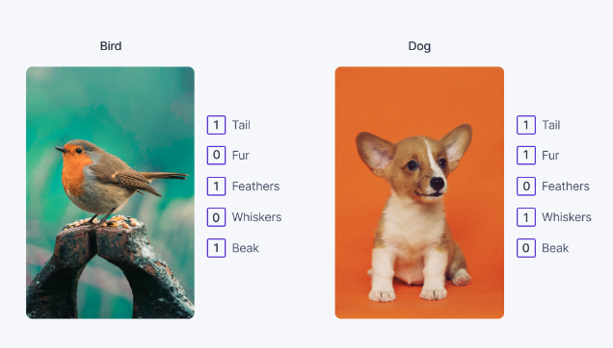
Introduction
Zero-shot learning
How? Semantic information! (= side information)
Zero-shot learning도 지도학습
Train (labeled set of data)
Semantic embedding
Vector을 활용해 Class 간 거리 계산 (cosine similarity)
Get auxiliary information :existing knowledge
Knowledge can be transferred in the semantic space
Test (Unseen data)
input: (image, side information)
새로운 클래스로 분류
*Few-shot learning
Image by rawpixel.com on Freepik
Notes:
계산된 거리는 단어간의 의미적 유사도를 나타냄.
고차원의 sementic space
Transfer learning은 같은 차원에서의 전이와 다른 차원에서의 전이 학습으로 나눌 수 있는데, 제로샷 같은 경우에는 같은 차원에서의 전이학습으로 분류할 수 있습니다.

Slide 7
Motivation
NLP zero-shot training to CV

Slide 8
Motivation
Background
Learn image representations from text
- predict word in image caption
- transformer-based language modeling, masked language modeling, contrastive objectives
Trial
- zero-shot ImageNet (acc: 11.5%)
- narrow scope, well targeted weak supervision – predict Instagram images hashtag(acc: increase 5%)
- noisly labeled data의 class predict
Idea
Limited well labeled data & unlimited raw data 의 중도
-> Large scale에서 natural language supervision으로 훈련된 image classifier
Tomas Mikolov, C. Efficient Estimation of Word Representations in Vector Space

Slide 9
Main Method

Slide 10
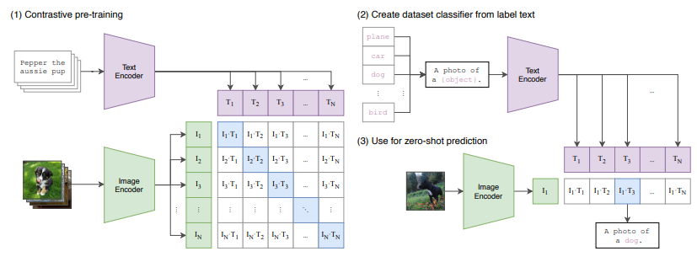
Sentimental Transfer Vector

Slide 11
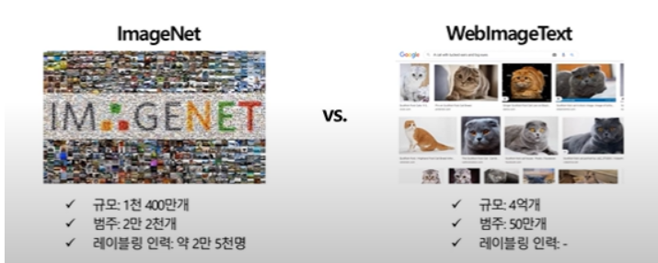
Contrastive Language-Image Pre-training
Dataset
:WIT (WebImageText)
인터넷 다양한 사이트에서 가져온 4억 개의 (image, text) 쌍

Slide 12
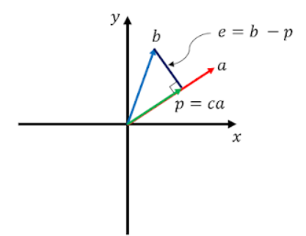
Contrastive Language-Image Pre-training
Contrastive learning
:extracting meaningful representations by contrasting positive and negative pairs of instances
Image, text embedding의 cosine similarity가 N real pair 에 대해서 극대화되도록 space학습. Optimize symmetric cross entropy loss.
Use linear projection to map each. encoder’s representation to multi-modal embedding space
Embedding
: Convert input sentence or image into a fixed-length vector
Notes:
Contrastive objectives 가 그들의 equivalent predictive objective 보다 더 representation을 잘 학습한다.
CLIP은 N개의 이미지-텍스트 쌍이 주어졌을 때, 어떤 NxN 쌍이 실제로 발생했는지 예측한다. 이를 위해 multi-modal embedding space를 학습한다. 이미지 인코더와 텍스트 인코더가 N개의 실제 쌍에 대해서 cosine 유사도가 극대화되고, 나머지 쌍은 최소화되도록.

Slide 13
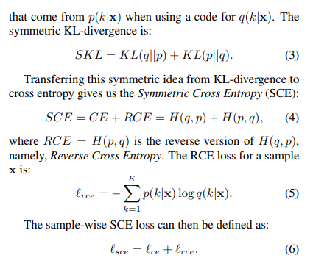
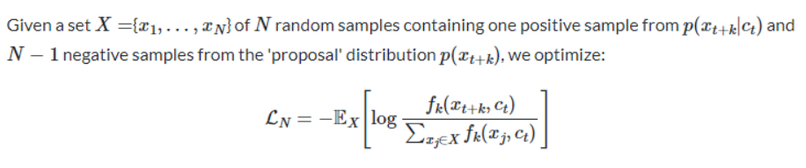
Contrastive Language-Image Pre-training
1) Cross entropy= 실제 분포와 모델로 예측된 분포의 차이
cross-entropy 설명
2) Symmetric cross entropy(클래스 불균형 문제에 용이/noisy label data)
3) InfoNCE Loss
분자: 입력단어와 실제 문맥단어 간 유사도
분모: 입력단어와 다른 후보단어들 간 유사도
Notes:
Noisy labeled data에 좋다고 함

Slide 14
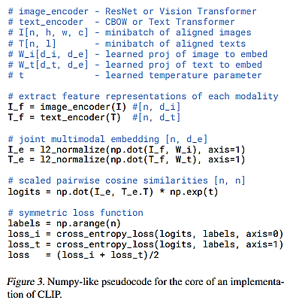
Contrastive Language-Image Pre-training
Image encoder: ResNet or ViT(vision transformer)
Text encoder: Transformer
[EOS] 토큰에서 마지막 layer가 텍스트의 feature representation
- layer normalized
- linear projection to embedding space
Temperature parameter tau
- Controls the range of the logits in the softmax
- Optimized during training

Slide 15
Contrastive Language-Image Pre-training
Zero-shot transfer learning
Compute feature embedding for each image, text
Calculate cosine similarity
Scaled by tau, normalized into probability
distribution by softmax
[Dataset]
Name of all classes - set of potential text pairings
(image, text)
Predict most probable (image, text) pair
Prediction layer
:multinomial logistic regression classifier (=softmax classifier)
Notes:
Image encoder은 computes feature representation of image
Text encoder은 텍스트를 class가 대표하는 시각적 개념에 기반해서 선형 분류의 가중치를 생성

Slide 16
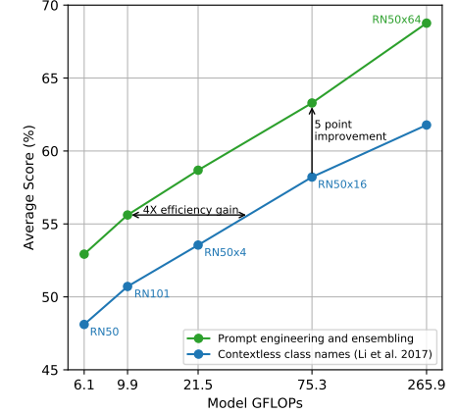
Contrastive Language-Image Pre-training
Ensemble
Experiment
Ensemble multiple zero-shot classifier
‘‘A photo of a big {label}”
“A photo of a small {label}”
- construct over embedding space instead of probability space
-> Make compute cost low
Prompt engineering
Problem 1. Polysemy issue(다의어)
Problem 2. paired text is not single word
Distribution gap
prompt template 사용
Customize prompt text
performance

Slide 17
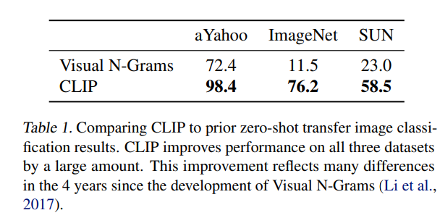
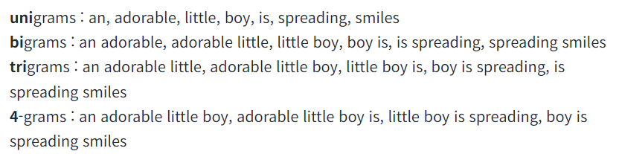
Contrastive Language-Image Pre-training
Experiment
- Contextual comparison to Visual N-Grams
Result
N-gram model
: Use the precious N-1 words to predict the next one

Slide 18
Result

Slide 19
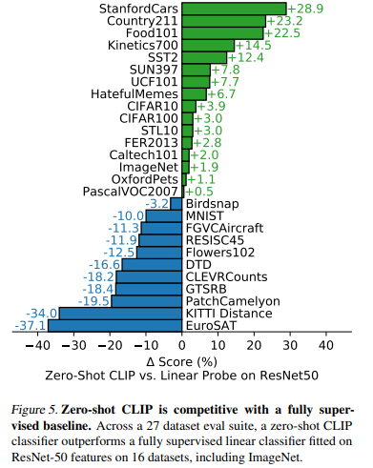
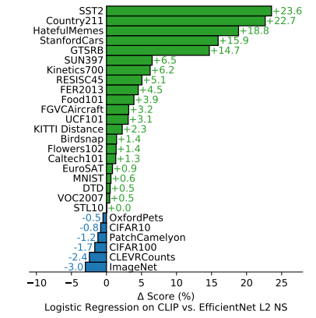
Contrastive Language-Image Pre-training
Zero shot & representation learning code
Performance
Zero-shot transfer learning
Representation learning

Slide 20
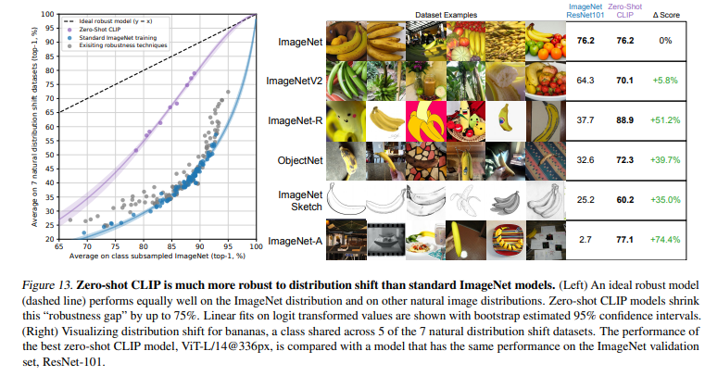
Contrastive Language-Image Pre-training
Performance
Robustness to natural distribution shift
(train data와 test data 의 distribution 차이)

Slide 21
Fin.

